Slide 1
What are we going to see in this session?
Code structure
Sample codes for other service provider
Certification details

Slide 2
Code structure
Small scale infrastructure :
We can maintain very basic code structure in small-scale infrastructure.
Minimum files required are.
main.tf [provider & resource]
vars.tf [variables declared]
terraform.tfvars [variables & credentials defined]
output.tf [optional]
backend.tf [optional]
Medium & Large-scale infrastructure :
Medium scale infrastructure are well structured with modules
Minimum files required are.
Modules
main.tf, output.tf, vars.tf
Prod
main.tf
Staging
main.tf

Slide 3
Sample codes for other service provider
Vmware
Azure
GCP

Slide 4
Certification details
Certification

Slide 5
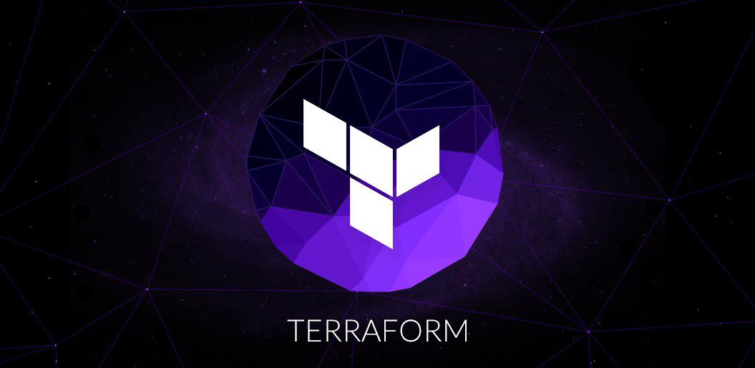
End of this topic !
Any questions?

